Slide 1

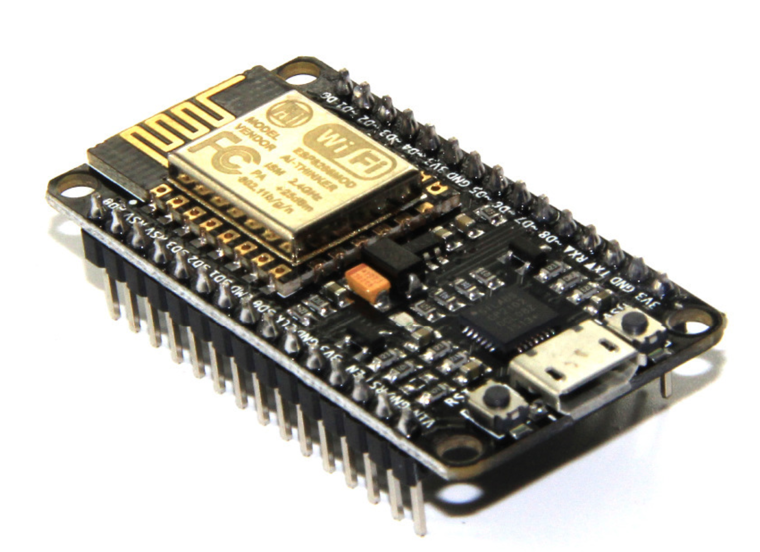
NODE MCU
Presented by: Mohammad Tahir Mirji
BE,MTech CSE

Slide 2
What Is NodeMCU?
NodeMCU is an open source platform based on ESP8266 which can connect objects and let data transfer using the Wi-Fi protocol. In addition, by providing some of the most important features of microcontrollers such as GPIO, PWM, ADC, and etc, it can solve many of the project’s needs alone.
Easy to use
Programmability with Arduino IDE or IUA languages
Available as an access point or station
practicable in Event-driven API applications
Having an internal antenna
Containing 13 GPIO pins, 10 PWM channels, I2C, SPI, ADC, UART, and 1-Wire
In order to use Arduino IDE to program the NodeMCU, you have to introduce it to the software at first.

Slide 3
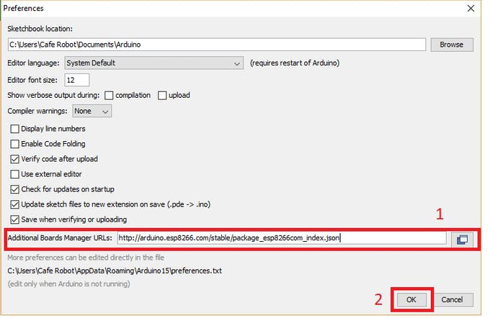
Node MCU Setup
http://arduino.esp8266.com/stable/package_esp8266com_index.json

Slide 4
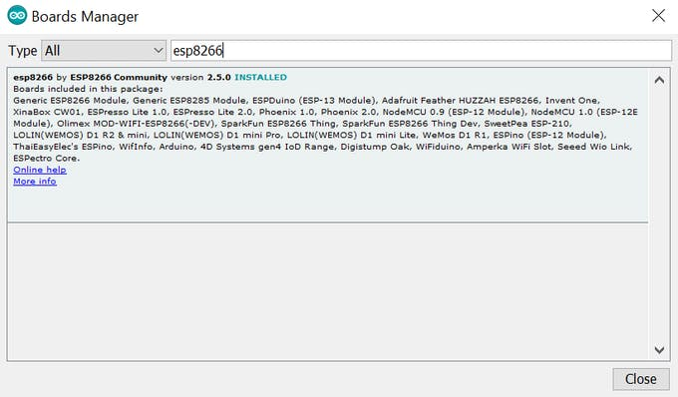
Node MCU Setup

Slide 5
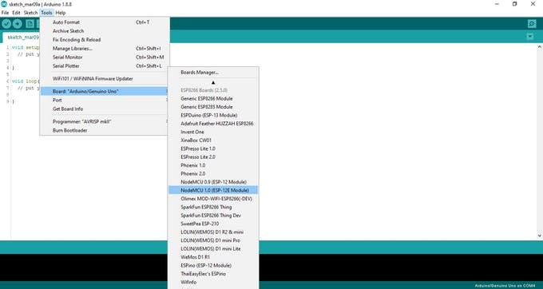
Node MCU Board Selection

Slide 6
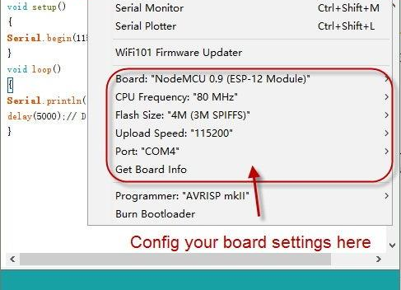
IDE Setup
void setup()
{
Serial.begin(115200);//Set the baudrate to 115200,same as the software settings
}
void loop()
{
Serial.println("Hello World!");//Print character string“Hello World！”on the serial
delay(5000);// Delay 5 second
}

Slide 7
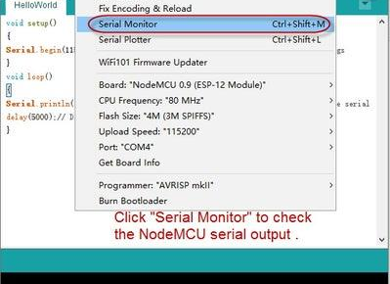
IDE Setup

Slide 8
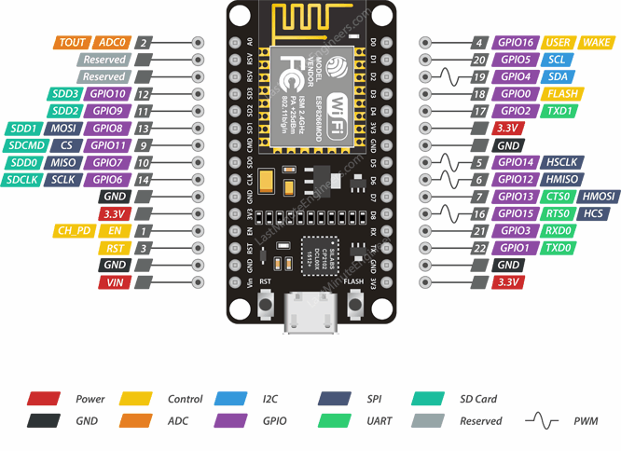
PINOUT Diagram
In order to use digital pins, you should select GPIO numbers. For example, the D7 pin is defined as GPIO13.
So you should set up the pin number 13 whenever you want to use D7 in your program. Also, you can use pin D2(GPIO4) as SDA and pin D1(GPIO5) as SCL

Slide 9
Controlling LED through an HTTP page Using NodeMCU
You can connect the internet through Wi-Fi using NodeMCU, and apply your desired commands by creating an HTTP page.In this example, you can control an LED by pressing the ON and OFF key. Enter your modems SSID and password in the provided part and upload it on your NodeMCU board using Arduino IDE. (Leave other settings to the default)
#include <ESP8266WiFi.h>
#include <WiFiClient.h>
#include <ESP8266WebServer.h>
/* Set these to your desired credentials. */
const char *ssid = "*****"; //Enter your WIFI ssid
const char *password = "*****"; //Enter your WIFI password
ESP8266WebServer server(80);
void handleRoot() {
server.send(200, "text/html", "<form action=\"/LED_BUILTIN_on\" method=\"get\" id=\"form1\"></form><button type=\"submit\" form=\"form1\" value=\"On\">On</button><form action=\"/LED_BUILTIN_off\" method=\"get\" id=\"form2\"></form><button type=\"submit\" form=\"form2\" value=\"Off\">Off</button>");
}

Slide 10
void handleSave() {
if (server.arg("pass") != "") {
Serial.println(server.arg("pass"));
}
}
void setup() {
pinMode(LED_BUILTIN, OUTPUT);
delay(3000);
Serial.begin(115200);
Serial.println();
Serial.print("Configuring access point...");
WiFi.begin(ssid, password);
while (WiFi.status() != WL_CONNECTED) {
delay(500);
Serial.print(".");
}

Slide 11
Serial.println("");
Serial.println("WiFi connected");
Serial.println("IP address: ");
Serial.println(WiFi.localIP());
server.on ( "/", handleRoot );
server.on ("/save", handleSave);
server.begin();
Serial.println ( "HTTP server started" );
server.on("/LED_BUILTIN_on", []() {
digitalWrite(LED_BUILTIN, 1);
Serial.println("on");
handleRoot();
});
server.on("/LED_BUILTIN_off", []() {
digitalWrite(LED_BUILTIN, 0);
Serial.println("off");
handleRoot();
});
}
void loop() {
server.handleClient();
}
After opening the Serial Monitor, if the Internet connection is established, you will be given the IP address of the page you have created (for example 192.168.1.18).copy and paste it in your browser to open the HTTP page.

Slide 12
Connect LED Via Wifi
#include <ESP8266WiFi.h>
const char *ssid = "YOUR SSID"; //put your SSID
const char *password = "YOURPASSWORD";//put your password
int ledPin = 12; // GPI12
WiFiServer server(80);
void setup() {
Serial.begin(115200);
delay(10);
pinMode(ledPin, OUTPUT);
digitalWrite(ledPin, LOW);
// Connect to WiFi network
Serial.println();
Serial.println();
Serial.print("Connecting to ");
Serial.println(ssid);
WiFi.begin(ssid, password);

Slide 13
Connect LED Via Wifi
while (WiFi.status() != WL_CONNECTED) {
delay(500);
Serial.print(".");
}
Serial.println("");
Serial.println("WiFi connected");
// Start the server
server.begin();
Serial.println("Server started");
// Print the IP address
Serial.print("Use this URL to connect: ");
Serial.print("http://");
Serial.print(WiFi.localIP());
Serial.println("/");
}

Slide 14
Connect LED Via Wifi
void loop() {
// Check if a client has connected
WiFiClient client = server.available();
if (!client) {
return;
}
// Wait until the client sends some data
Serial.println("new client");
while(!client.available()){
delay(1);
}
// Read the first line of the request
String request = client.readStringUntil('\r');
Serial.println(request);
client.flush();
// Match the request
int value = LOW;
if (request.indexOf("/LED=ON") != -1) {
digitalWrite(ledPin, HIGH);
value = HIGH;
}
if (request.indexOf("/LED=OFF") != -1) {
digitalWrite(ledPin, LOW);
value = LOW;
}

Slide 15
Connect LED Via Wifi
// Set ledPin according to the request
//digitalWrite(ledPin, value);
// Return the response
client.println("HTTP/1.1 200 OK");
client.println("Content-Type: text/html");
client.println(""); // do not forget this one
client.println("<!DOCTYPE HTML>");
client.println("<html><body>");
client.print("Led pin is now: ");
if(value == HIGH) {
client.print("On");
} else {
client.print("Off");
}
client.println("<br><br>");
client.println("Click <a href=\"/LED=ON\">here</a> turn the LED on pin 2 ON<br>");
client.println("Click <a href=\"/LED=OFF\">here</a> turn the LED on pin 2 OFF<br>");
client.println("</body></html>");
delay(1);
Serial.println("Client disonnected");
Serial.println("");
}

Slide 16
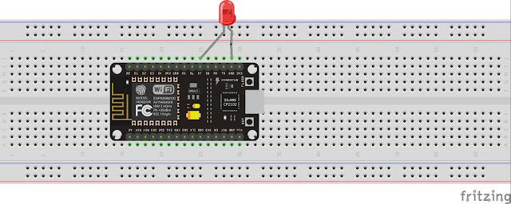
Circuit Diagram

